Slide 1
INTRODUCTION CASE STUDY – BELLABEAT (How Can a Wellness Technology Company Play It Smart?)
Welcome to the Bellabeat data analysis case study! In this case study, we shall be look at many real-world tasks of a junior data analyst. Working for Bellabeat, a high-tech manufacturer of health-focused products for women, and meet different characters and team members. In order to answer the key business questions, following the steps of the data analysis process: ask, prepare, process, analyze, share, and act. Along the way, the Case Study Roadmap tables — including guiding questions and key tasks to stay on the right path.

Slide 2
SCENARIO
Working as junior data analyst working on the marketing analyst team at Bellabeat, a high-tech manufacturer of health-focused products for women. Bellabeat is a successful small company, but they have the potential to become a larger player in the global smart device market. Urška Sršen, cofounder and Chief Creative Officer of Bellabeat, believes that analyzing smart device fitness data could help unlock new growth opportunities for the company. Having been asked to focus on one of Bellabeat’s products and analyze smart device data to gain insight into how consumers are using their smart devices. The insights discovered will then help guide marketing strategy for the company. I will be presenting my analysis to the Bellabeat executive team along with your high-level recommendations for Bellabeat’s marketing strategy.

Slide 3
About the company
Urška Sršen and Sando Mur founded Bellabeat, a high-tech company that manufactures health-focused smart products. Sršen used her background as an artist to develop beautifully designed technology that informs and inspires women around the world. Collecting data on activity, sleep, stress, and reproductive health has allowed Bellabeat to empower women with knowledge about their own health and habits. Since it was founded in 2013, Bellabeat has grown rapidly and quickly positioned itself as a tech-driven wellness company for women. By 2016, Bellabeat had opened offices around the world and launched multiple products. Bellabeat products became available through a growing number of online retailers in addition to their own e-commerce channel on their website. The company has invested in traditional advertising media, such as radio, out-of-home billboards, print, and television, but focuses on digital marketing extensively. Bellabeat invests year-round in Google Search, maintaining active Facebook and Instagram pages, and consistently engages consumers on Twitter. Additionally, Bellabeat runs video ads on Youtube and display ads on the Google Display Network to support campaigns around key marketing dates. Sršen knows that an analysis of Bellabeat’s available consumer data would reveal more opportunities for growth. She has asked the marketing analytics team to focus on a Bellabeat product and analyze smart device usage data in order to gain insight into how people are already using their smart devices. Then, using this information, she would like high-level recommendations for how these trends can inform Bellabeat marketing strategy

Slide 4
The Data
FitBit Fitness Tracker Data (CC0: Public Domain, dataset made available through Mobius): This Kaggle data set contains personal fitness tracker from thirty fitbit users. Thirty eligible Fitbit users consented to the submission of personal tracker data, including minute-level output for physical activity, heart rate, and sleep monitoring. It includes information about daily activity, steps, and heart rate that can be used to explore users’ habits.
Working with this dataset, after downloading the FitBit Fitness Tracker Data (CC0: Public Domain, dataset made available through Mobius): This Kaggle data set contains personal fitness tracker from thirty fitbit users.Daily Activities merged dataset (dailyActivity_Merged)
Download the dataset. 2. Unzip the files. 3. Create a folder on your desktop or Drive to house the files. Use appropriate file-naming conventions. Working on the datasets (dailyActivity_merged and sleepDay_merged)

Slide 5
PROCESS PHASE OF THE DATA ANALYSIS WORKING ON SPREADSHEET / MICROSOFT EXCEL
By importing data into Excel Microsoft worksheet, the following steps were taken:
Exploring and cleaning the dataset
1. Cleaning the dataset: Checking out for error, trailing spaces, spellings, missing values, inconsistencies and outliers, and removing duplicates standardizing formats for consistencies in the dataset.
2. Exploring the dataset: Understanding the variables, distributions, and relationships within the data.
Using Pivot table: Summarizing and organizing the dataset. Using tools like Totals, Average or Count. Analyzing trends or patterns.
3. Analyzing the data with a chart: By plotting a scatter plot on the Excel Microsoft sheet, we can visualization the data and draw inferences.

Slide 6
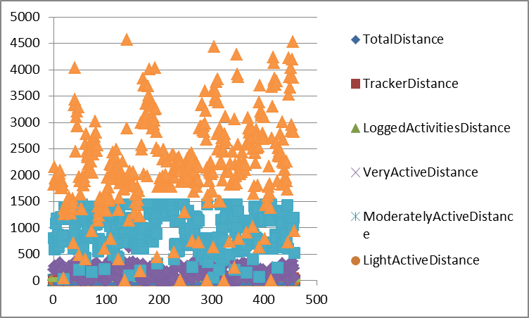
Visualization Chart on Microsoft Excel

Slide 7
Working SQL
Uploading the dailyAcitiv file in BigQuery:
Working through the process of uploading your CSV file to start working with your data in SQL. Data import basics:
Querying the data in the database: To understand the relationship between tables in the dailyActivities_Merged dataset.
Cleaning string variables using SQL: Cleaning techniques for string data in SQL. Exploring string data by counting the occurrence of specific words, extracting substrings, searching for patterns using SQL functions like SUBSTRING, REPLACE and LIKE.
EXAMPLE
-SELECT SUBSTRING( column_name, start_position, length) AS new_column_name
-FROM table_name

Slide 8
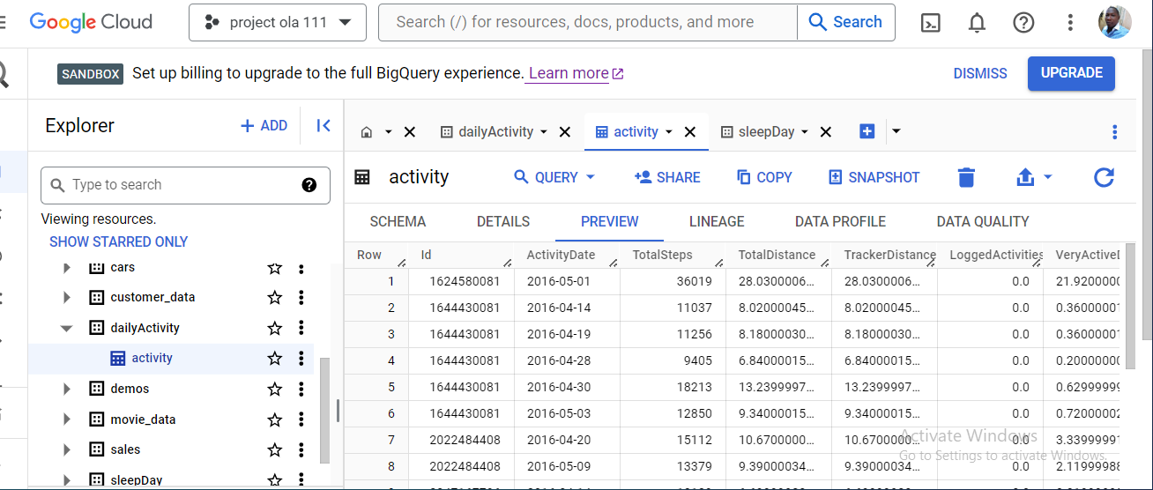
WORKING ON BigQuery SQL (screenshot)

Slide 9
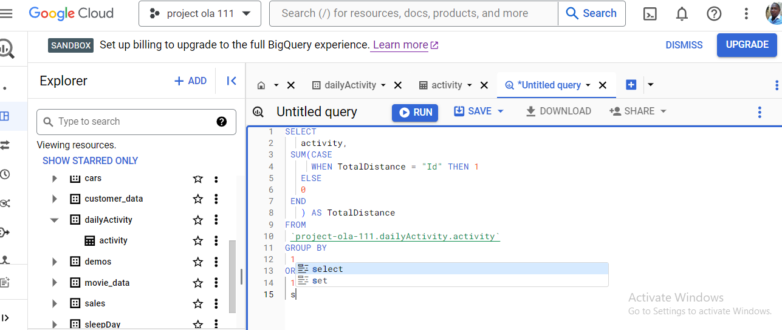
QUERYING THE DATASET ON BigQuery (screenshot)

Slide 10
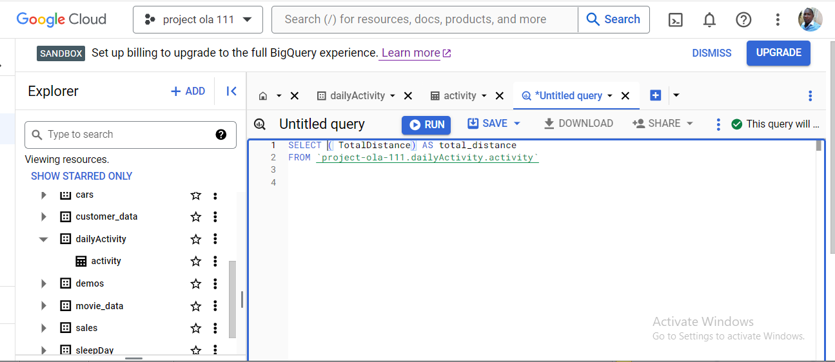
RUNNING QUERY ON BigQuery (screenshots)

Slide 11
WORKING IN THE RSTUDIO
Upload your CSV files to R
Install and load the tidyverse install.packages('tidyverse')
library(tidyverse
Create a dataframe named 'daily_activity' and read in one
of the CSV files from the dataset. Remember, you can name your dataframe
something different, and you can also save your CSV file under a different name as well.
daily_activity <- read.csv("dailyActivity_merged.csv")
Create another dataframe for the sleep data.
sleep_day <- read.csv("sleepDay_merged.csv")
Explore a few key tables
Plotting a few explorations
ggplot(data=daily_activity, aes(x=TotalSteps, y=SedentaryMinutes)) + geom_point()
ggplot(data=sleep_day, aes(x=TotalMinutesAsleep, y=TotalTimeInBed)) + geom_point()
Merging the two datasets together
combined_data <- merge(sleep_day, daily_activity, by="Id")

Slide 12
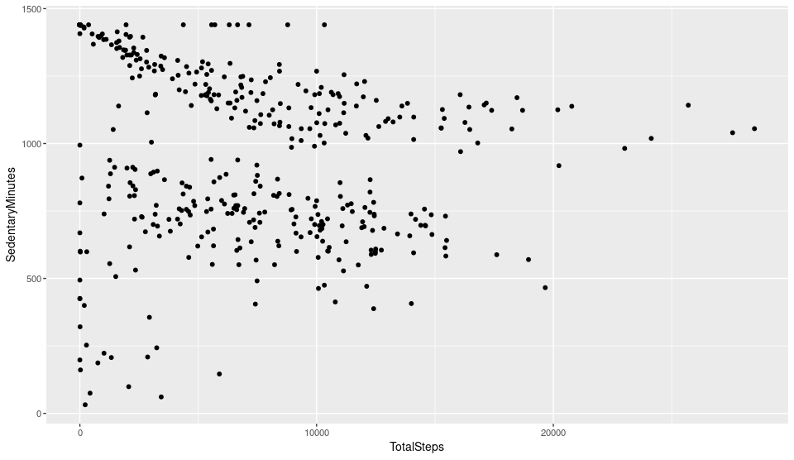
VISUALIZATION IN R STUDIO (ggplot(data=daily_activity, aes(x=TotalSteps, y=SedentaryMinutes)) + geom_point()

Slide 13
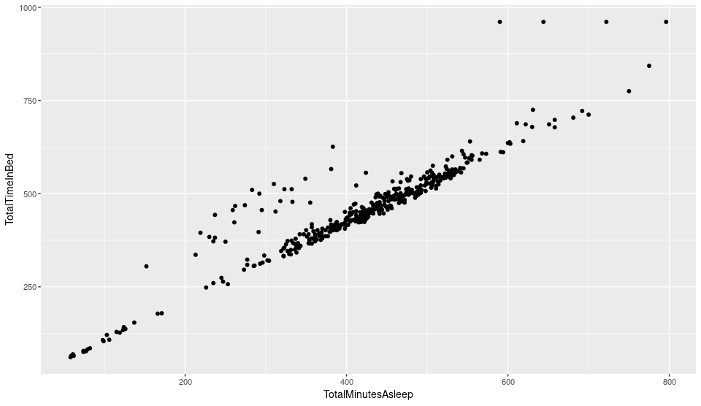
VISUALIZATION IN R STUDIO (ggplot(data=sleep_day, aes(x=TotalMinutesAsleep, y=TotalTimeInBed)) + geom_point()

Slide 14
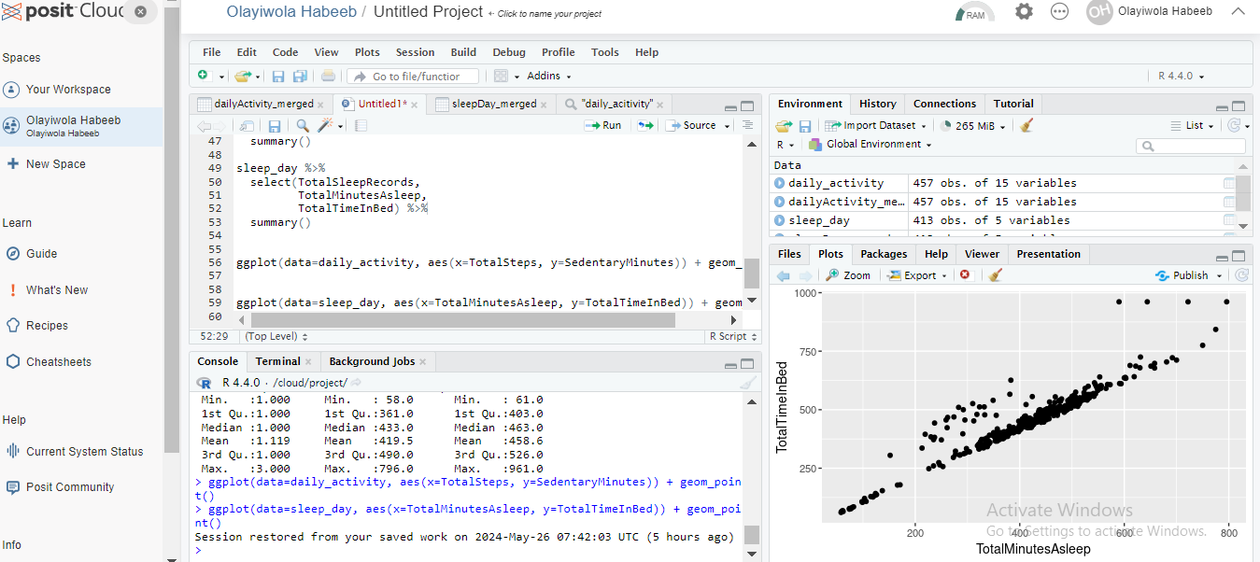
SCREENSHOTS OF R STUDIO

Slide 15
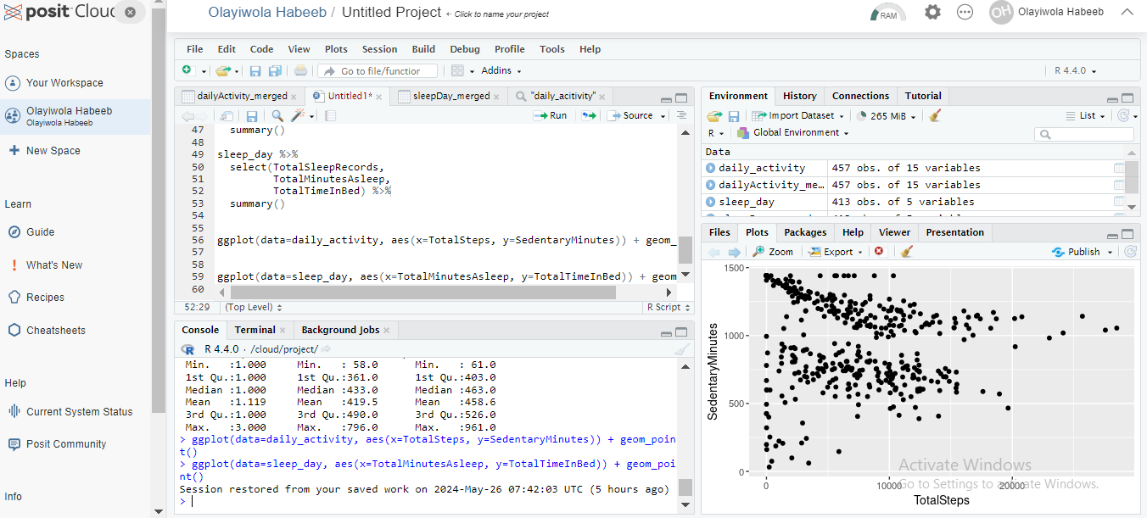
SCREENSHOTS ON R STUDIO

Slide 16
SUMMARY
Having completed this case study of Bellabeats, we can infer from all the data phases of the analysis what the data is trying to us, what insight can be drawn from the analysis so far.
From the visualization in R, in the sleepDay_merged csv dataset, we can conclude that:
There is positive correlation between (TotalTimetinBed) and (TotalMinutesAsleep)
The longer the time in bed the longer the sleep time
From the dailyActivity_merged csv dataset, we can conclude that:
1. There is no positive correlation between SedentaryMinutes and TotalSteps.
2. The Total steps is not related to the sedentary minutes.

Slide 17
CONCLUSION AND RECOMMENDATION
After thorough analysis of the data from the task given by the executives of the Bellabeat
Company we can answer the key business question following the data analysis process.
Having been asked to focus on one of Bellabeat’s products and analyze smart device data to gain insight into how consumers are using their smart devices. The insights discovered will then help guide marketing strategy for the company. I will be presenting my analysis to the Bellabeat executive team along with your high-level recommendations for Bellabeat’s marketing strategy.
From our analysis, we can conclude that the smart device has helped to gain insightful decisions that There is positive correlation between (TotalTimetinBed) and (TotalMinutesAsleep)
The longer the time in bed the longer the sleep time
With this, the company can re-strategize and focus on ways of improving the quality of the high- tech device to produce better performance to serve the customers better.
(How Can a Wellness Technology Company Play It Smart?)
The company can play it smart by re strategizing and focus more of ways of improving their high-tech devices to produce better performance to serve their customers better.

